Slide 1
Powered by Google Developers
ML from Scratch

Slide 2
Agenda
About the club
What is Machine Learning
Timeline
Types of Learning
Resources

Slide 3
Developer Student Clubs
This is a community group for students in their undergraduate or graduate term.
Recognized by Google Developers.
Here’s the primary aim: Create an impact with technology.
Why are you here? : We will give you the tools, YOU will build whatever you want to build.

Slide 4

What is ML?
Formal Definition Approach
“A computer program is said to learn from experience E with respect to some class of tasks T and performance measure P if its performance at tasks in T, as measured by P, improves with experience E.”- Tom Mitchell
Notes:
Explain this definition graphically

Slide 5
An Informal Approach
Machine learning is an application of artificial intelligence (AI) that provides systems the ability to automatically learn and improve from experience without being explicitly programmed.

Slide 6
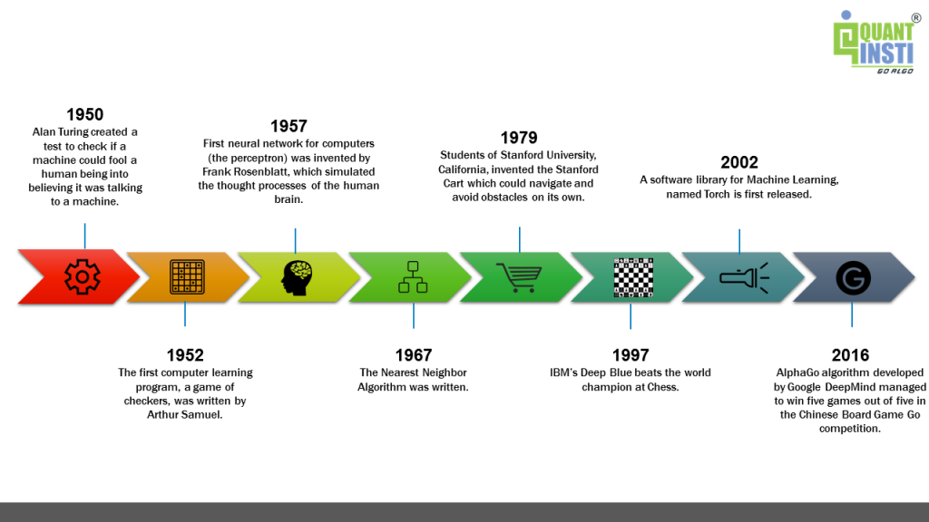
What you see now has come a long way

Slide 7
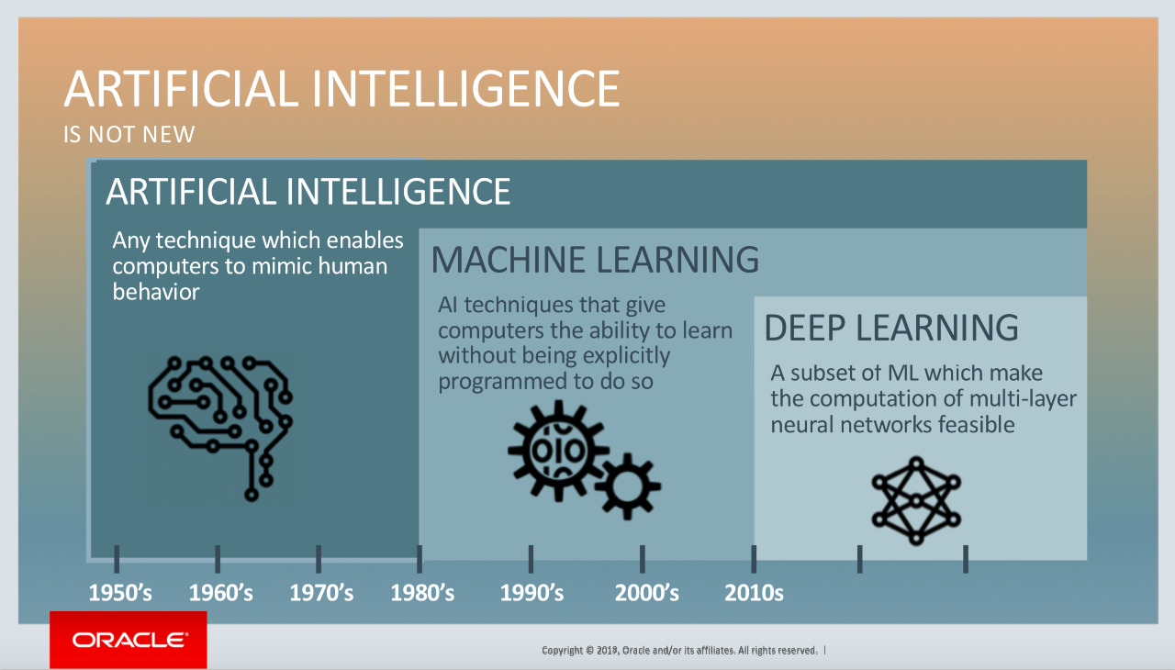
Difference between AI, ML, DL
Notes:
It’s not the same!

Slide 8
Day to day Applications
1. Virtual Personal Assistants
Siri, Alexa, Google Now are some of the popular examples of virtual personal assistants. As the name suggests, they assist in finding information, when asked over voice. All you need to do is activate them and ask “What is my schedule for today?”
2. Predictions while Commuting
When booking a cab, the app estimates the price of the ride. When sharing these services, how do they minimize the detours? The answer is machine learning.

Slide 9
4. Social Media Services
People you may know: Facebook continuously notices the friends that you connect with, the profiles that you visit very often, your interests, workplace, or a group that you share with someone etc
Face Recognition: ou upload a picture of you with a friend and Facebook instantly recognizes that friend. Facebook checks the poses and projections in the picture, notice the unique features, and then match them with the people in your friend list.

Slide 10
5. Email Spam and Malware Filtering
There are a number of spam filtering approaches that email clients use. To ascertain that these spam filters are continuously updated, they are powered by machine learning. When rule-based spam filtering is done, it fails to track the latest tricks adopted by spammers.
8. Product Recommendations
You shopped for a product online few days back and then you keep receiving emails for shopping suggestions. If not this, then you might have noticed that the shopping website or the app recommends you some items that somehow matches with your taste.

Slide 11
Various Sectors where ML is used
Financial Services: Companies in the financial sector are able to identify key insights in financial data as well as prevent any occurrences of financial fraud, with the help of machine learning technology. The technology is also used to identify opportunities for investments and trade.
Healthcare: With the advent of wearable sensors and devices that use data to access health of a patient in real time,
Notes:
Financial Services: Usage of cyber surveillance helps in identifying those individuals or institutions which are prone to financial risk, and take necessary actions in time to prevent fraud.
Healthcare: ML is becoming a fast-growing trend in healthcare. Sensors in wearable provide real-time patient information, such as overall health condition, heartbeat, blood pressure and other vital parameters. Doctors and medical experts can use this information to analyze the health condition of an individual, draw a pattern from the patient history, and predict the occurrence of any ailments in the future.

Slide 12
Marketing and Sales: Product Recommendations. Remember?
Notes:
Companies are using machine learning technology to analyze the purchase history of their customers and make personalized product recommendations for their next purchase. This ability to capture, analyze, and use customer data to provide a personalized shopping experience is the future of sales and marketing.

Slide 13
Fun Time!
https://quickdraw.withgoogle.com/

Slide 14
Supervised Learning
Supervised learning as the name indicates the presence of a supervisor as a teacher. Basically supervised learning is a learning in which we teach or train the machine using data which is well labeled that means some data is already tagged with the correct answer.
Notes:
Supervised Learning: After that, the machine is provided with a new set of examples(data) so that supervised learning algorithm analyses the training data(set of training examples) and produces a correct outcome from labeled data.

Slide 15
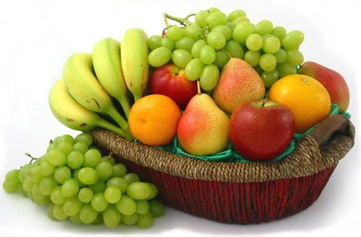
Example of Supervised Learning

Slide 16
No. | SIZE | COLOR | SHAPE | FRUIT NAME
1 | Big | Red | Rounded shape with depression at the top | Apple
2 | Small | Red | Heart-shaped to nearly globular | Cherry
3 | Big | Green | Long curving cylinder | Banana
4 | Small | Green | Round to oval,Bunch shape Cylindrical | Grape

Slide 17
Unsupervised Learning
Unsupervised learning is the training of machine using information that is neither classified nor labeled and allowing the algorithm to act on that information without guidance. Here the task of machine is to group unsorted information according to similarities, patterns and differences without any prior training of data.
Notes:
Unlike supervised learning, no teacher is provided that means no training will be given to the machine. Therefore machine is restricted to find the hidden structure in unlabeled data by our-self.

Slide 18
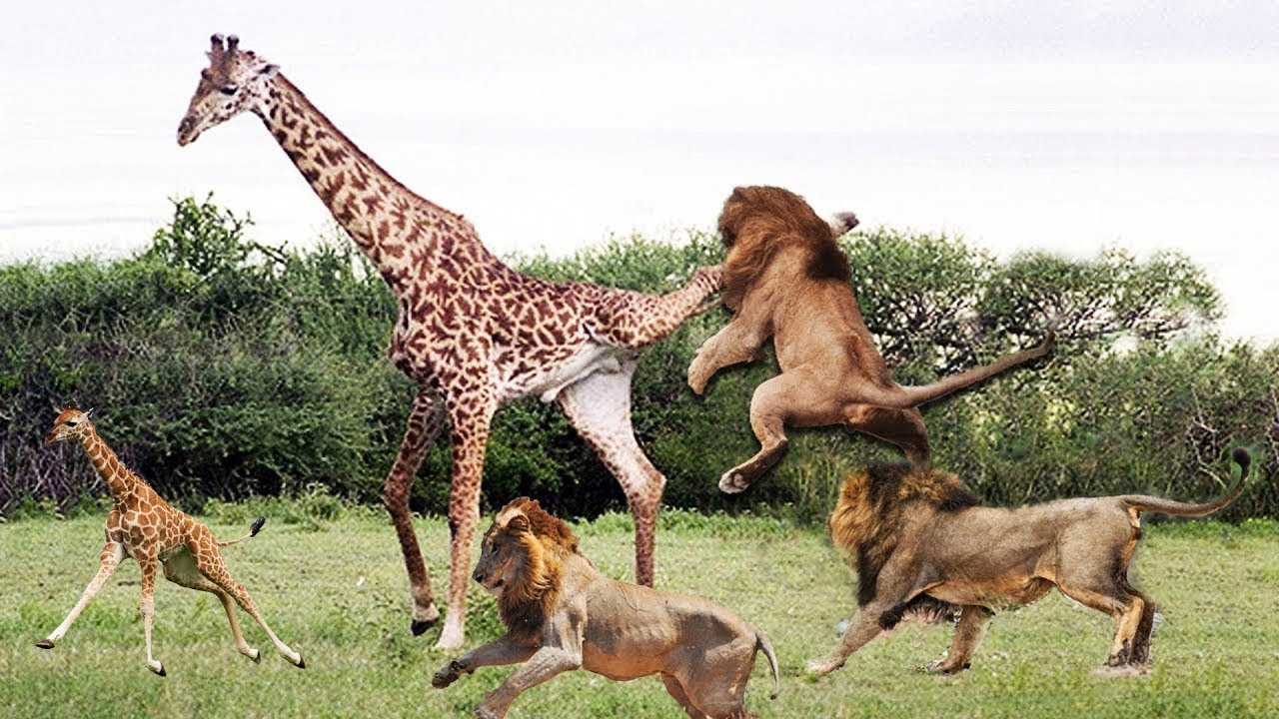

Slide 19
It’s Quiz Time
1) Based on past information about spams, filtering out a new incoming email into Inbox (normal) or Junk folder (Spam).
2) Biometric attendance or ATM etc systems where you train the machine after couple of inputs (of your biometric identity - be it thumb or iris or ear-lobe, etc.), machine can validate your future input and identify you.
3) Suppose a machine is given some pics of various vehicles. The model doesn’t know what that vehicle is.

Slide 20
Supervised Learning

Slide 21
Classification
A classification problem is when the output variable is a category, such as “red” or “blue” or “disease” and “no disease”.
A classification model attempts to draw some conclusion from observed values. Given one or more inputs a classification model will try to predict the value of one or more outcomes.
Notes:
For example, when filtering emails “spam” or “not spam”, when looking at transaction data, “fraudulent”, or “authorized”.

Slide 22
Regression
A regression problem is when the output variable is a real value, such as “dollars” or “weight”.
Eg: Predicting age of a person, house price etc.

Slide 23

Resources
Andrew Ng’s Machine Learning (Coursera)
Sudheshna Sarkar’s Introduction to Machine Learning (NPTEL IIT Kgp)
machinelearningmastery.com
Towards Data Science (Medium Blog)

Slide 24
Thank You!

